Slide 1

HR DATA ANALYSIS PSYLIQ Internship
Presented By:
Kuruva Ashok Kumar

Slide 2
INTRODUCTION:
This dataset is related to the HR DATA ANALYSIS and Provided by PSYLIQ. In this project I explored the various aspects of human resource management and how they affect business outcomes.
The Dataset contains 5000 employees details from a large company such as their age, gender, education, department, salary, performance etc.
Technologies Required : Excel, Powe Bi
Technical Skills : Power query to combine 5 tables, Data Cleansing, Data Exploration, data Visualization, data interpretation etc.
Presented By:
Kuruva Ashok Kumar

Slide 3
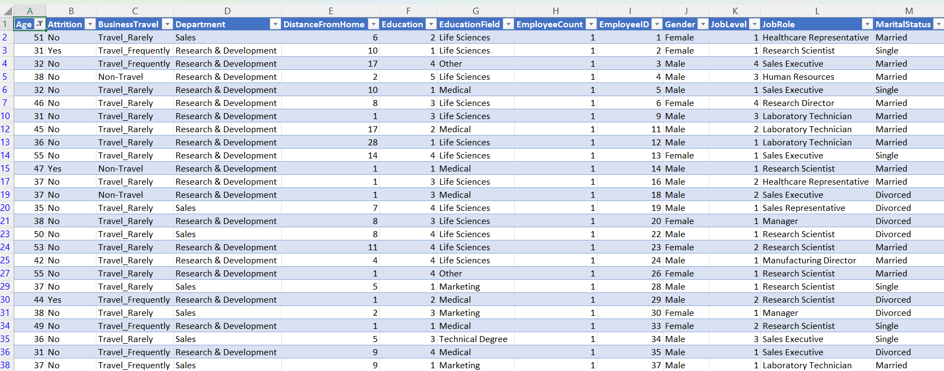
1. Using Excel, how would you filter the dataset to only show employees aged 30 and above?
Presented By:
Kuruva Ashok Kumar

Slide 4
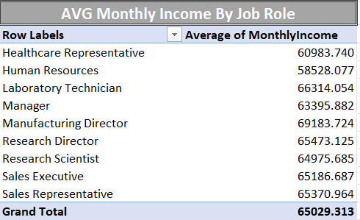
2. Create a pivot table to summarize the average Monthly Income by Job Role
Presented By:
Kuruva Ashok Kumar

Slide 5
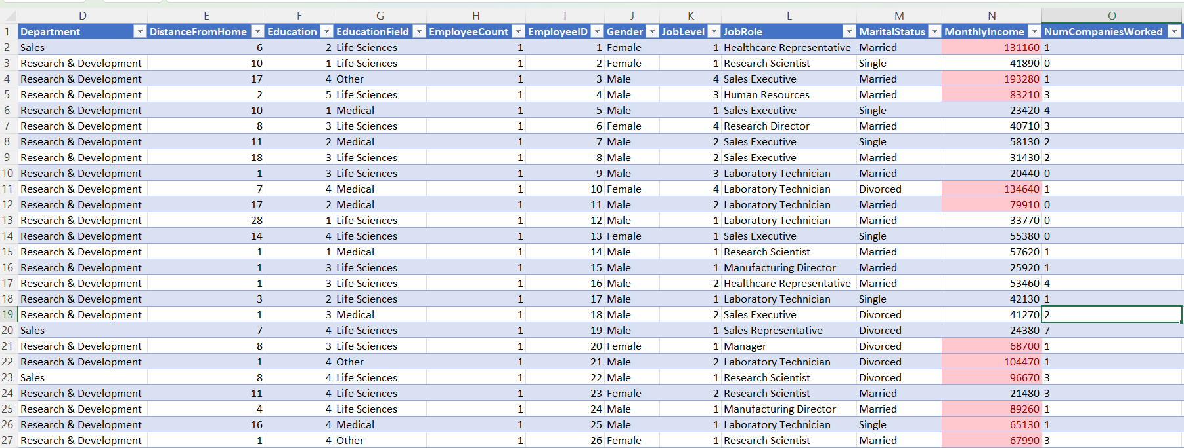
3. Apply conditional formatting to highlight employees with Monthly Income above the company's average income.
Presented By:
Kuruva Ashok Kumar

Slide 6
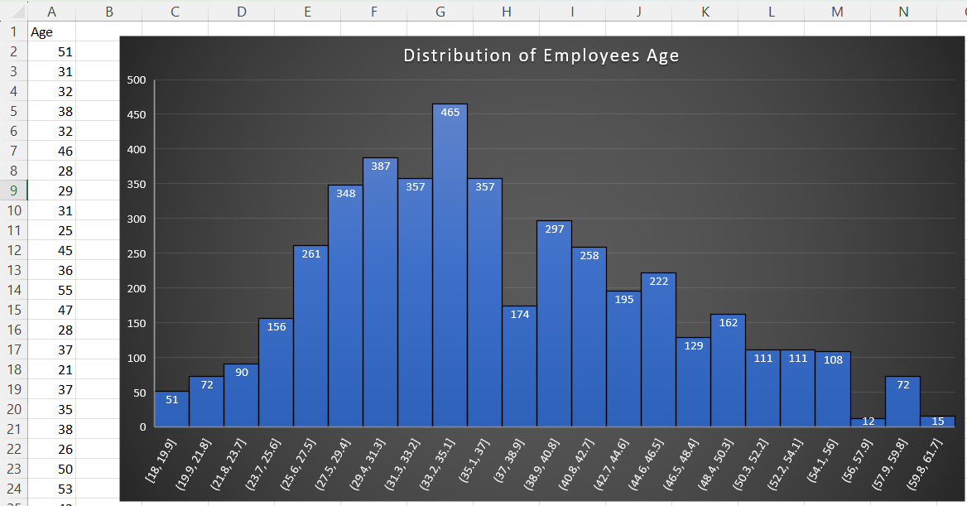
4. Create a bar chart in Excel to visualize the distribution of employee ages
Presented By:
Kuruva Ashok Kumar

Slide 7
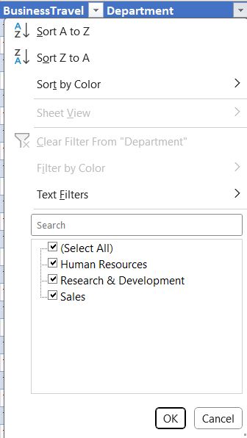
5. Identify and clean any missing or inconsistent data in the "Department" column.
Presented By:
Kuruva Ashok Kumar

Slide 8
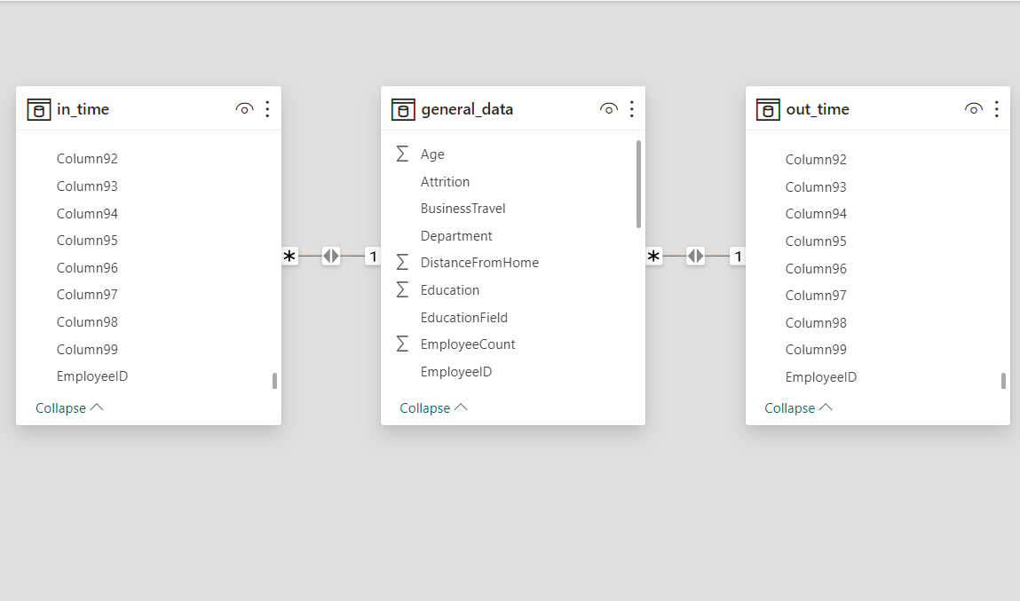
6. In Power BI, establish a relationship between the "EmployeeID" in the employee data and the "EmployeeID" in the time tracking data.
Presented By:
Kuruva Ashok Kumar

Slide 9
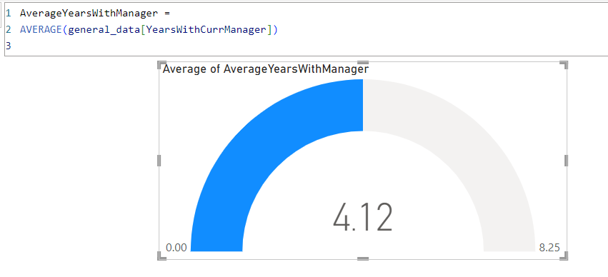
7. Using DAX, create a calculated column that calculates the average years an employee has spent with their current manager.
Presented By:
Kuruva Ashok Kumar

Slide 10
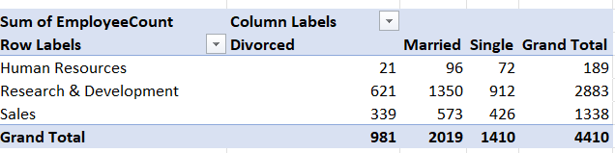
8. Using Excel, create a pivot table that displays the count of employees in each Marital Status category, segmented by Department.
Presented By:
Kuruva Ashok Kumar

Slide 11
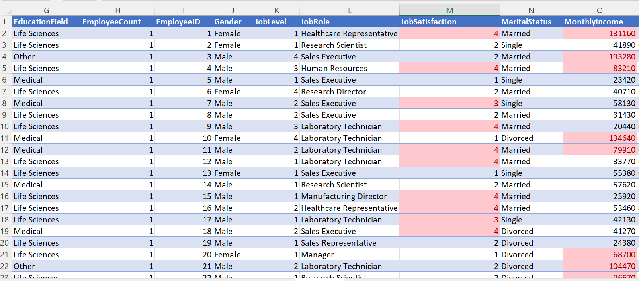
9. Apply conditional formatting to highlight employees with both above-average Monthly Income and above-average Job Satisfaction.
Presented By:
Kuruva Ashok Kumar

Slide 12
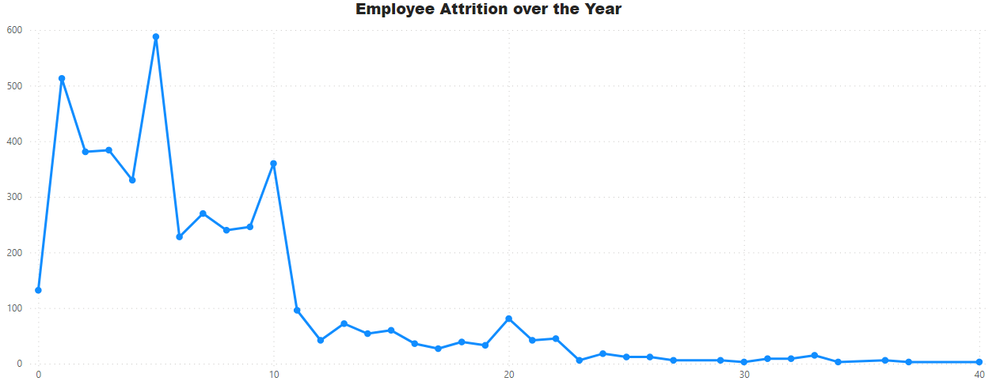
10.In Power BI, create a line chart that visualizes the trend of Employee Attrition over the years.
Presented By:
Kuruva Ashok Kumar

Slide 13
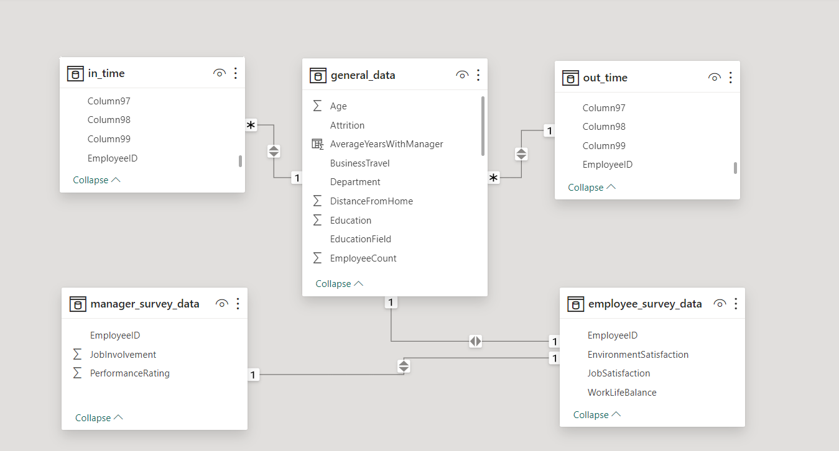
11. Describe how you would create a star schema for this dataset, explaining the benefits of doing so.
Presented By:
Kuruva Ashok Kumar

Slide 14
12. Using DAX, calculate the rolling 3-month average of Monthly Income for each employee.
Rolling 3-Month Average =
VAR LastDate = LASTDATE(“Employee”[Date])
RETURN
CALCULATE(
AVERAGEX(
VALUES(‘Employee’[EmployeeID]),
CALCULATE(SUM’[Employee’[Monthly Income]))
),
FILTER(
ALL’(Employee’),
‘Employee’[Date] <= LastDate &&
‘Employee’[Date] > DATEADD(LastDate, -3, Month)
)
)
Presented By:
Kuruva Ashok Kumar

Slide 15
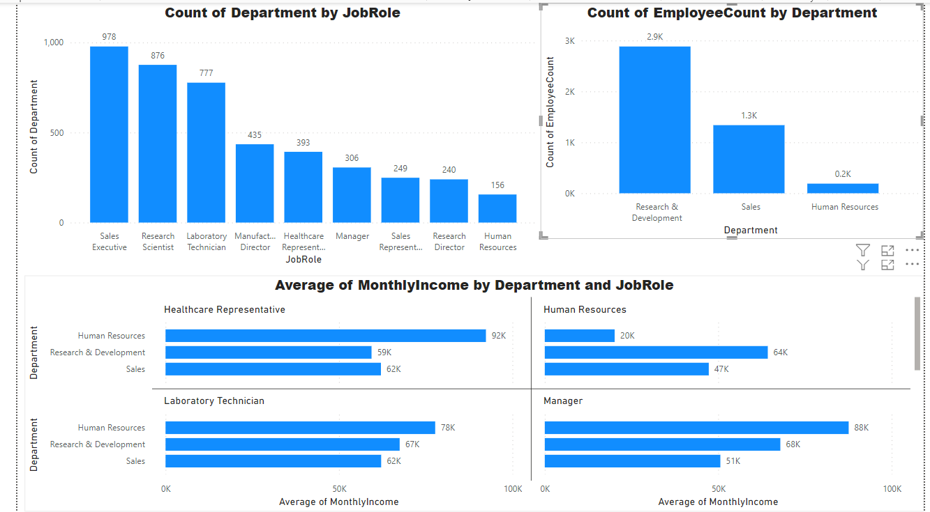
13. Create a hierarchy in Power BI that allows users to drill down from Department to Job Role to further narrow their analysis.
Presented By:
Kuruva Ashok Kumar

Slide 16
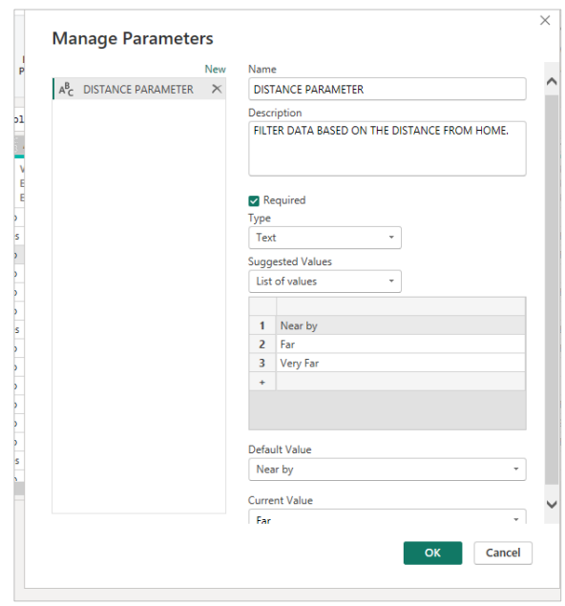
14. How can you set up parameterized queries in Power BI to allow users to filter data based 2 of 2 on the Distance from Home column?
Presented By:
Kuruva Ashok Kumar

Slide 17
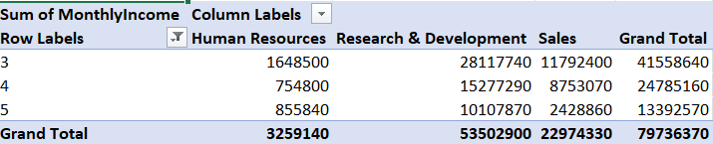
15. In Excel, calculate the total Monthly Income for each Department, considering only the employees with a Job Level greater than or equal to 3
Presented By:
Kuruva Ashok Kumar

Slide 18
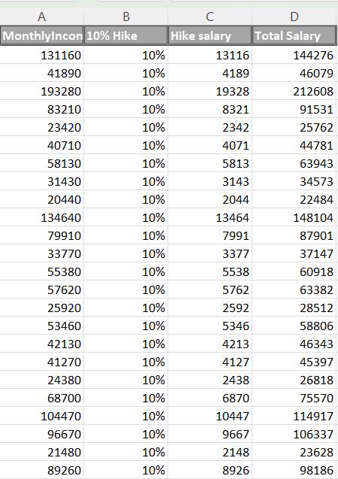
16. Explain how to perform a What-If analysis in Excel to understand the impact of a 10% increase in Percent Salary Hike on Monthly Income.
Presented By:
Kuruva Ashok Kumar

Slide 19
Review the Predefined Schema: Carefully examine the predefined schema to understand the expected structure, data types, and constraints. Check each field or attribute against the schema to identify any deviations. Data Profiling: Conduct data profiling to analyze the content, quality, and structure of the data. Identify any anomalies, such as missing values, incorrect data types, or outliers. Data Cleaning: Cleanse the data to address inconsistencies and discrepancies. Standardize formats, correct errors, and remove duplicate or irrelevant records. Data Validation: Perform validation checks to ensure data accuracy and completeness. Validate data against business rules, referential integrity constraints, and domain-specific requirements. Error Handling: Implement error handling mechanisms to manage exceptions and invalid data. Log errors, notify stakeholders, and track data quality issues for resolution. Iterative Improvement: Continuously monitor and refine the data validation and cleansing procedures. Incorporate feedback and lessons learned to enhance data quality management practices.
17. Verify if the data adheres to a predefined schema. What actions would you take if you find inconsistencies?
Presented By:
Kuruva Ashok Kumar

Slide 20


